Slide 1
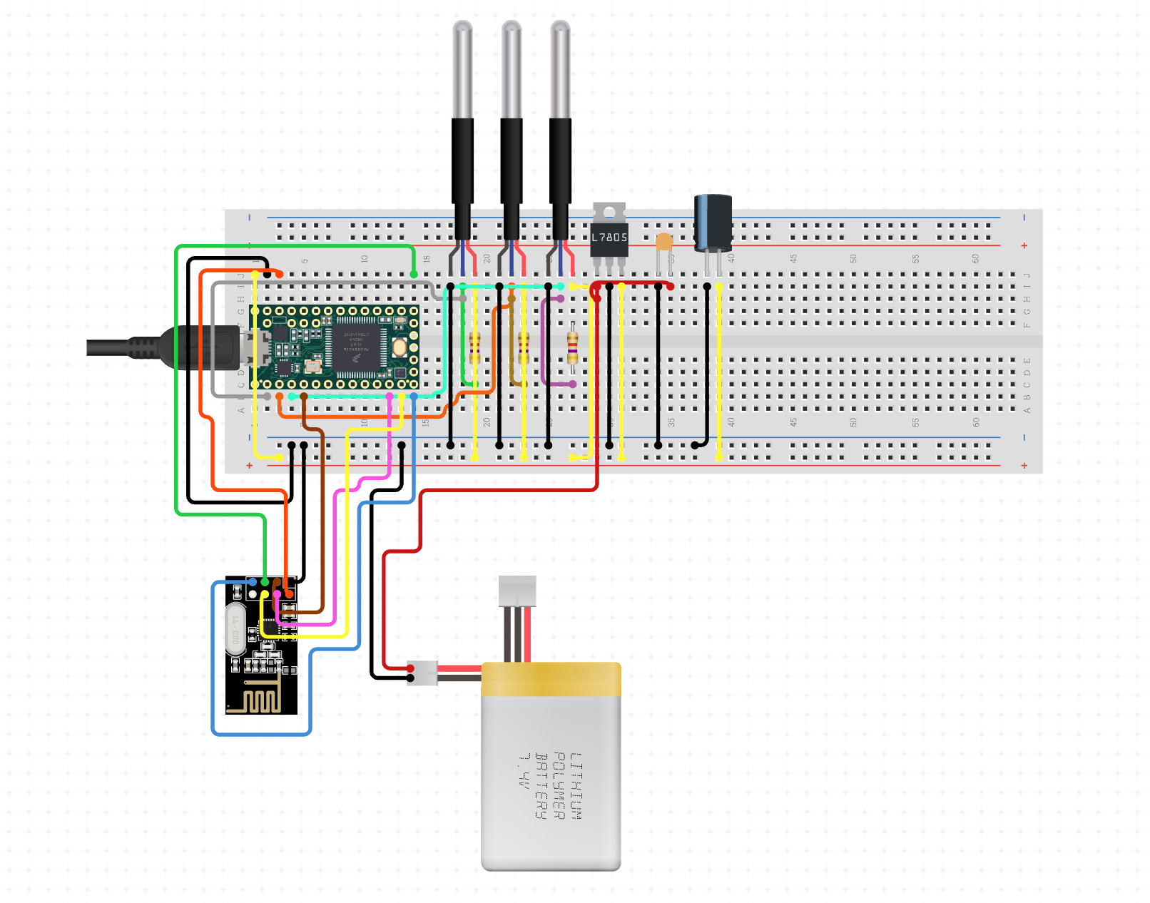
Moisture sensors x3
TTGO
LoRa
Lithium Battery

